Slide 1
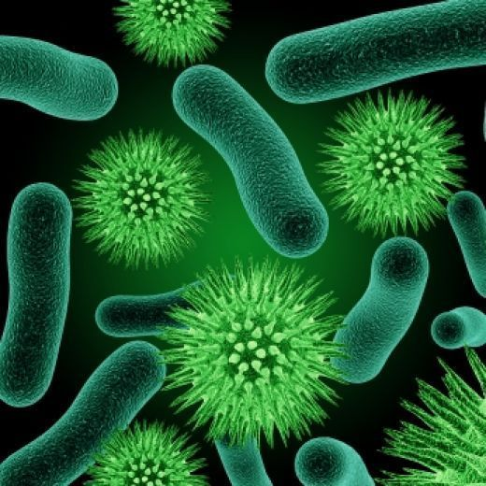
Microbes in Human Welfare

Slide 2
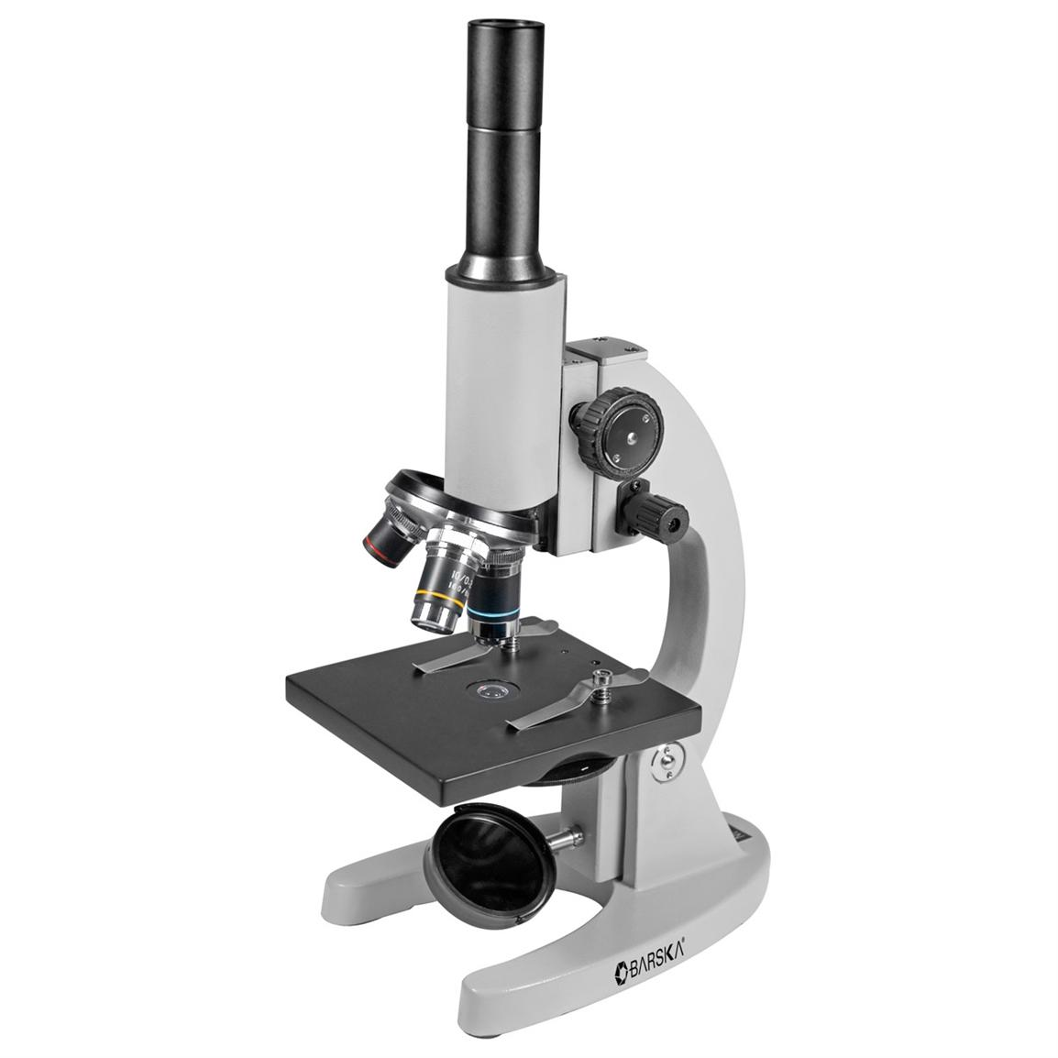
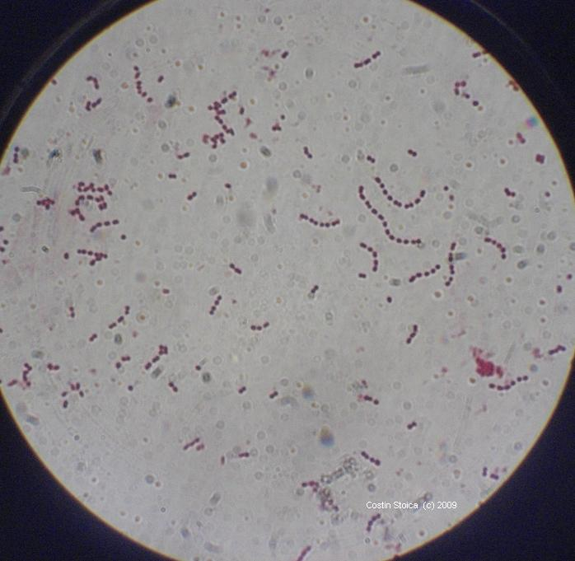
Microbes:
Microbes are the organism which can not be seen in naked eye. They can be seen under microscope.
Microbes are found in all habitat. They may be protozoans, fungi, bacteria or virus.
Most of the microbes are usefull to human beings. They are used in daily life in house hold products.

Slide 3
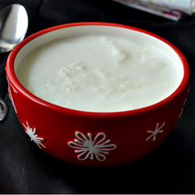
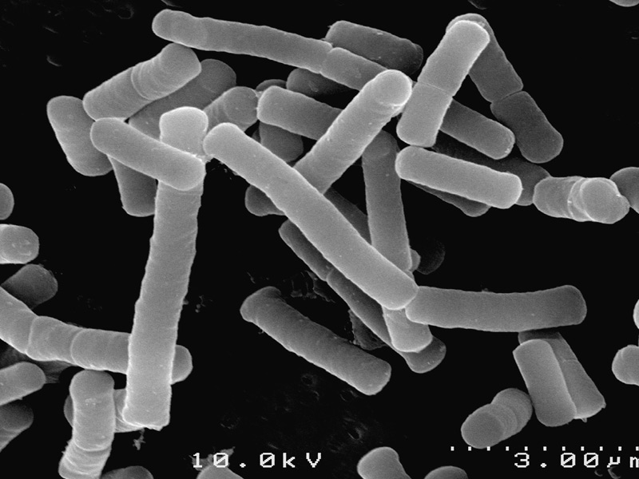
Ex:
1. Curd: curd is formed by adding small amount of curd to milk.
Lactobacillus bacteria and Lactic acid Bacteria (LAB) present in starter multiplies in suitable temp and converts milk in to curd.

Slide 4
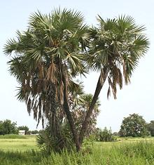
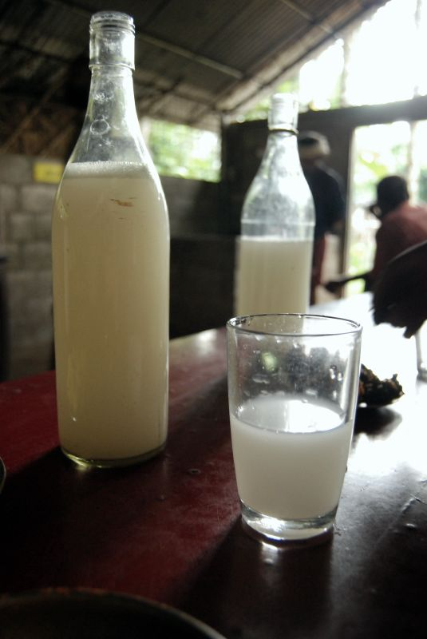
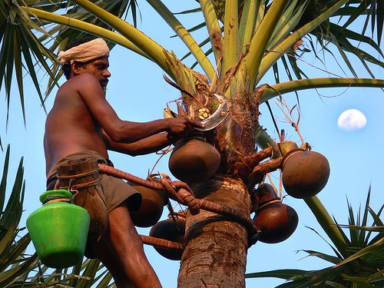
Toddy:
Traditional drink of south India made by fermentation of sap of palm tree by bacteria.

Slide 5
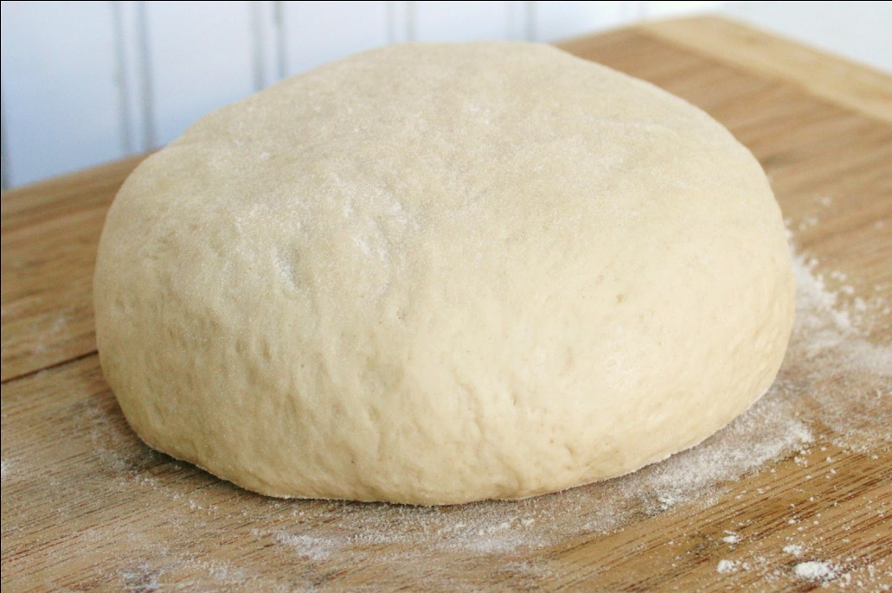
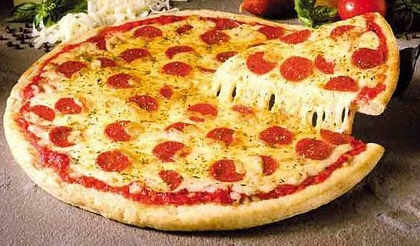
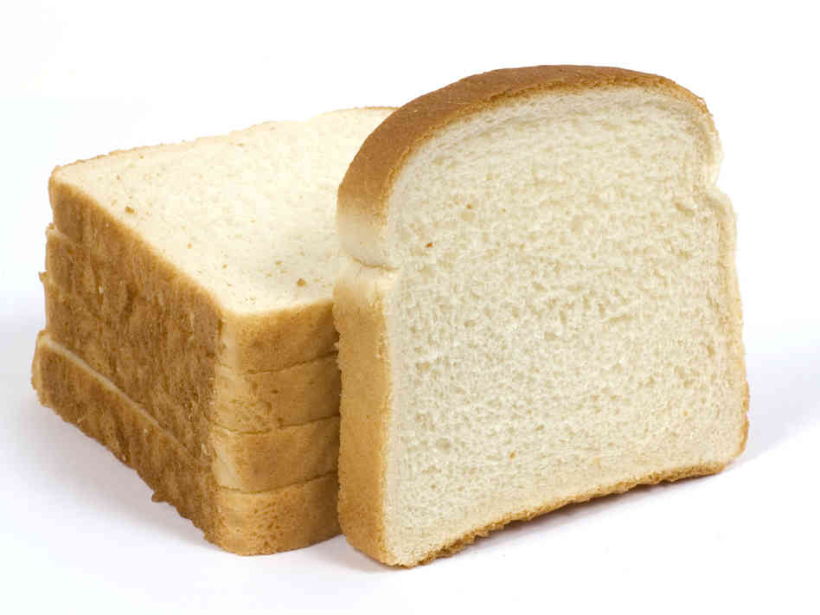
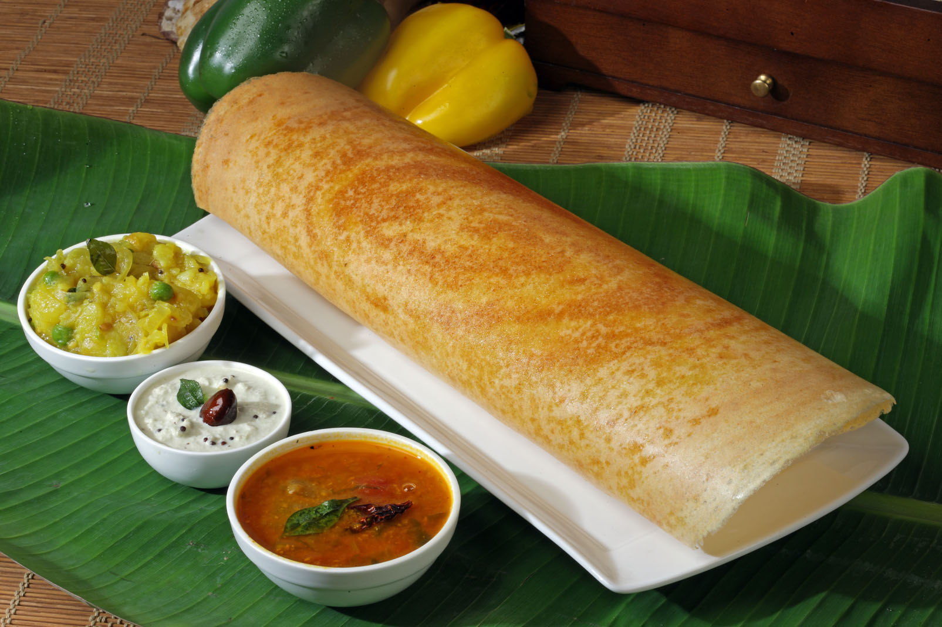
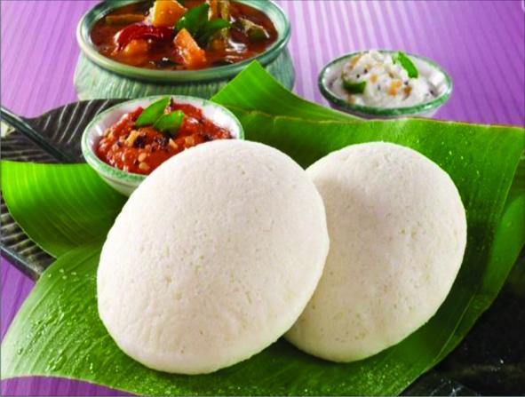
Dough and bread:
Dough is made by fermentation of bacteria.
The bread is made fermented by baker yeast Saccharomyces cervisiae.
It is also used in making Idli, dosa etc

Slide 6
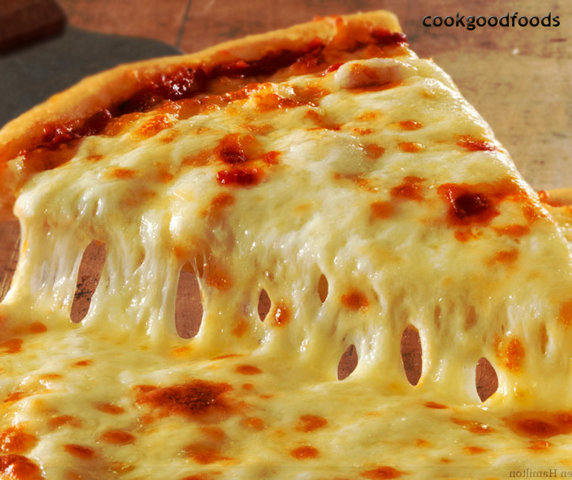
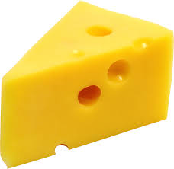
Cheese :
Cheese is made by partial degradation of milk using microbes.
Large holes in ‘Swiss cheese’ are due to production of large amount of CO2 by abacteria Propionibacterium sharmanii.

Slide 7
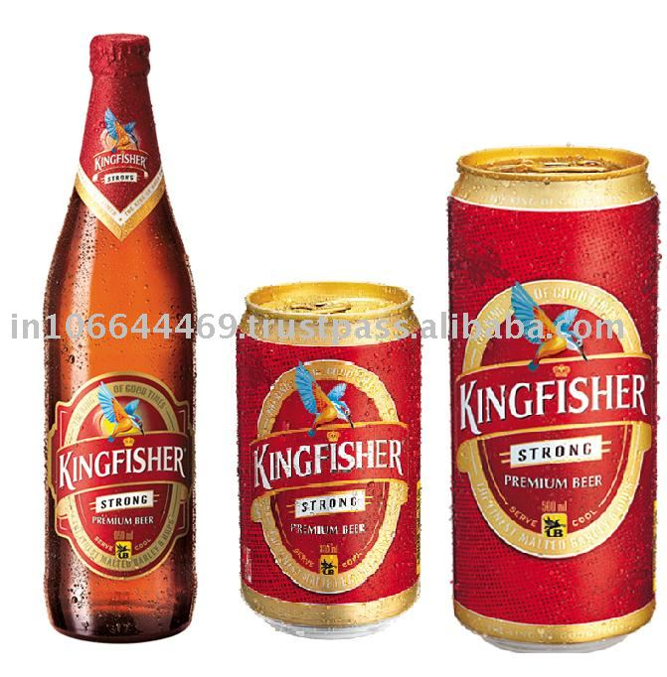

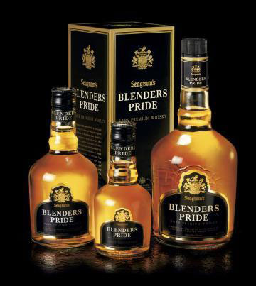
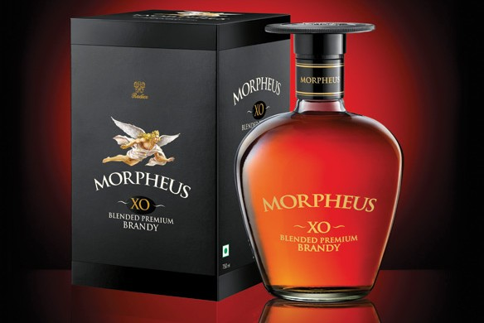
Microbes in industrial products:
Fermented beverages:
Alcoholic beverages are formed by fermenting malt and fruit juice by brewer’s yeast Saccharomyces cervisiae.
Wine and beer are produced with out distilation.
Wisky, brandy and rum are formed by distilation.

Slide 8
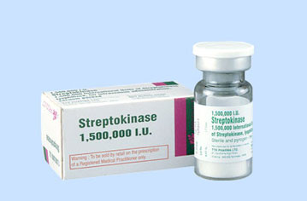
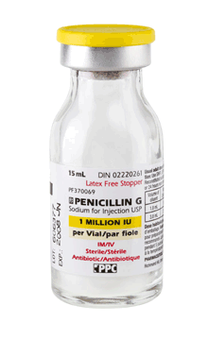
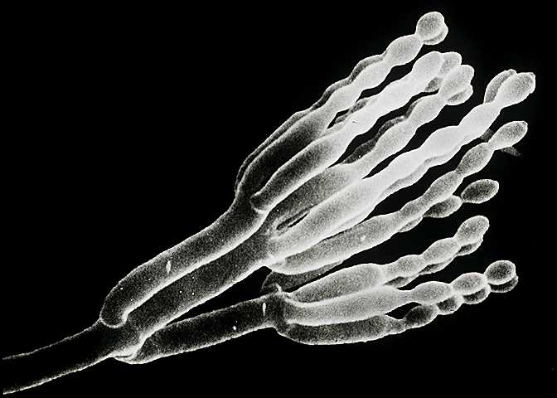
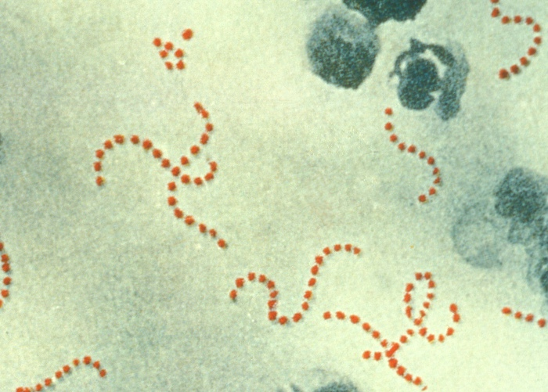
Antibiotics:
Alexander Fleming first discovered antibiotic penicillin from an fungi Penicillium notatum.
Penicillin is extracted by Penicillium notatum
It is used to cure many bacterial diseases.
Streptokinase is extracted by Streptococcus bacteria.
It is used as a ‘clot buster’, for removing clots from the blood vessels of patients who have undergone myocardial infarction.

Slide 9
Organic acids: The organic acids are extracted by microbes.
Citric acid is extracted by fungi Aspergillus.
Acetic acid is extracted by bacteria Acetobacter.
Lactic acid is extracted by lactobacillus.
Enzymes: useful enzymes of industrial importance are,
Proteases, Pectinases, Lipases, Cellulases. These are extracted by microbes.
Bioactive molecules:
Cyclosporin-A is produced by a fungus called Trichoderma polysporum.
It is used as immunosuppressive agent during organ transplantation.
Statins is produced by a fungus called Monascus purpureus
It is used as blood cholesterol lowering agents.

Slide 10
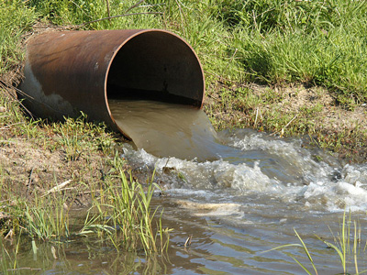
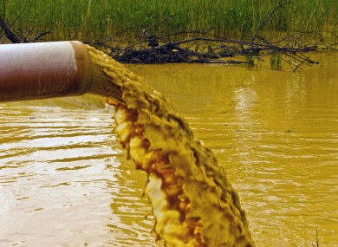
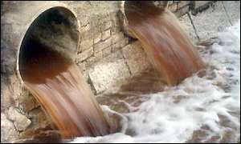
Microbes in sewage treatment:
Sewage is the municipal waste water containing large human excreta. It contains organic waste and pathogens.
Before discharging into natural water bodies sewage water is made less polluted by treating in sewage treatment plants (STPs).

Slide 11
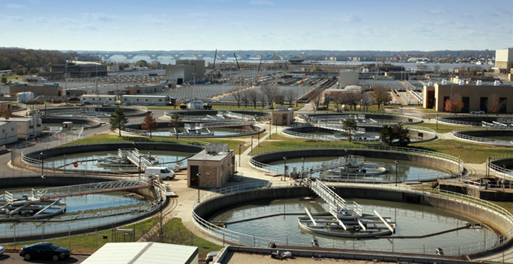
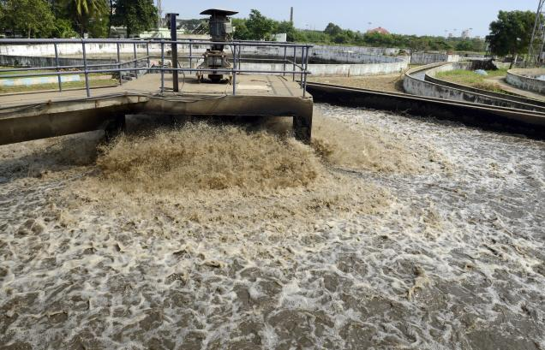
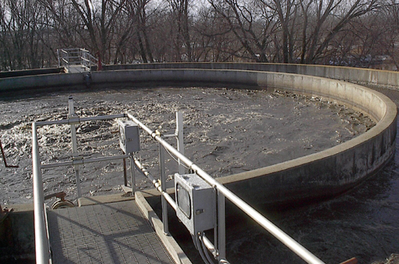
sewage treatment plants (STPs).

Slide 12
primary treatment of sewage water.
It involves the physical removal of sewage particles through filtration and sedimentation.
Initially floating debris is removed by filtration.
The grit (soil and small pebbles) are removed by sedimentation.
All solids that settle form the primary sludge, and the supernatant forms the effluents.
The effluents of the primary settling tank is taken for secondary treatment.

Slide 13
Secoundary treatment of sewage water:
The primary effluent is passed into large aeration tanks. This allows vigorous growth of useful aerobic microbes.
These microbes consumes the major part of the organic matter in the effluent.
This significantly reduces the BOD (biochemical oxygen demand) of the effluent.
Once the BOD of sewage reduced, the effluent is then passed into the settling tank. Where the bacterial ’flocs’ are allowed to sediment. This sediment is called activated sludge.
The sludge is pumped into anaerobic sludge digester.
In the anaerobic sludge digester anaerobic bacteria digest the bacteria and fungi in the sludge.
During this bacteria produce biogas.
The effluent from the secondary treatment plant is released into natural water body like rivers and streams.

Slide 14
BOD (Biochemical Oxygen Demand) :
BOD is the amount of oxygen required to oxidize total organic matter by bacteria, in one litter of water.
BOD measures the organic matter present in the water.
Greater the BOD of the waste water more is its polluting potential.

Slide 15
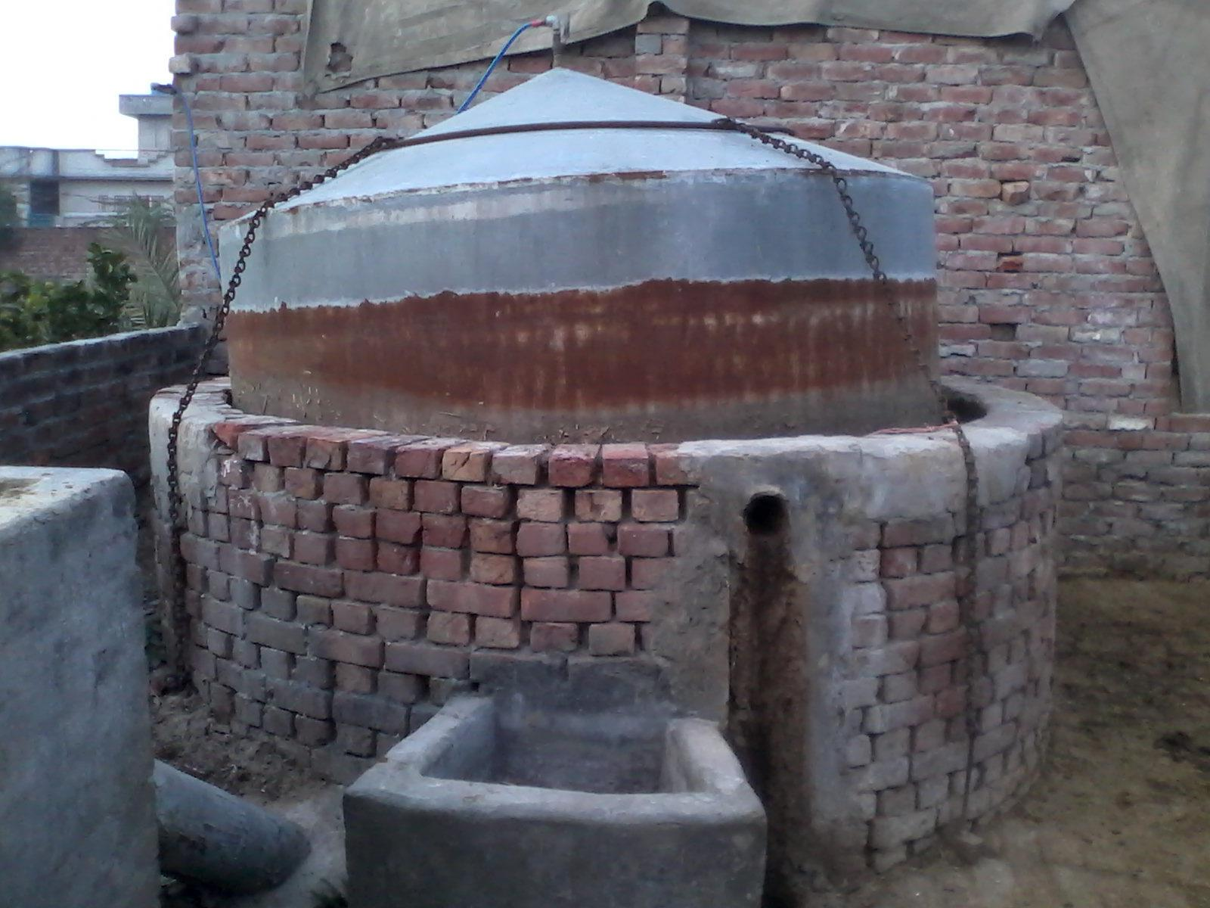
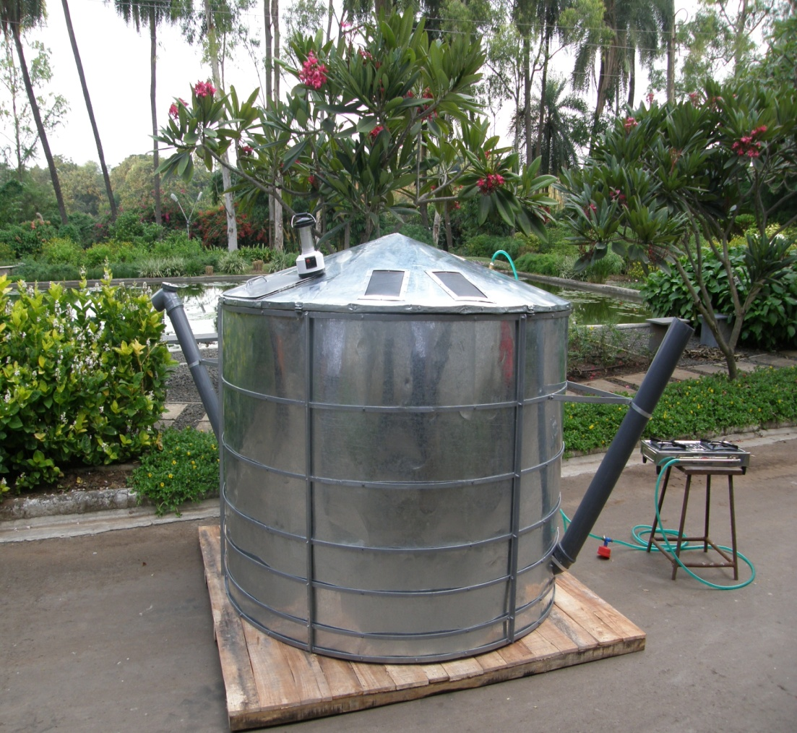
Biogas plant:
Biogas is a mixture of gases containing methane (CH4), carbon dioxide (CO2) and hydrogen (H2) gases produced by the microbial activity. It is used as fuel.

Slide 16
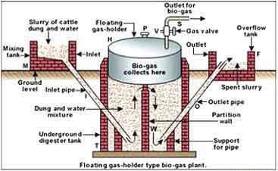
Structure of biogas plant:
The biogas plant consists of a concrete tank in which bio-wastes are collected and slurry of dung is fed.
A floating cover is placed over the slurry, which keeps on rising as the gas is produced in the tank due to microbial (methanogens) activity.
The biogas plant has an gas outlet, which is connected to a pipe to supply biogas to house.
Used slurry is removed through another outlet and may be used as fertiliser.
The biogas thus produced is used for cooking and lighting.

Slide 17
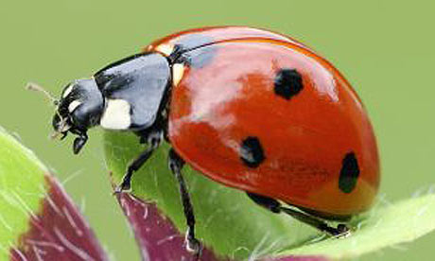
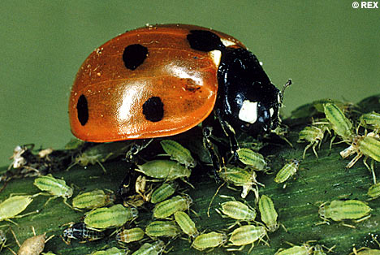
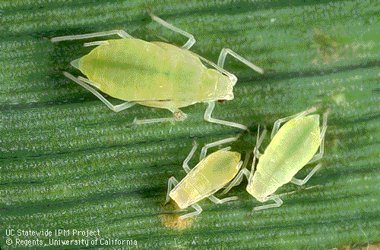
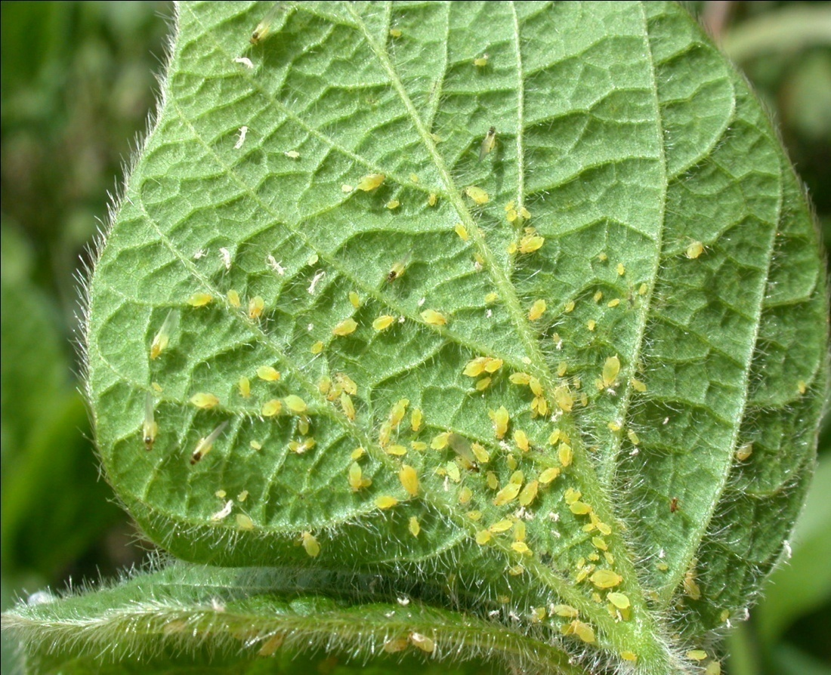
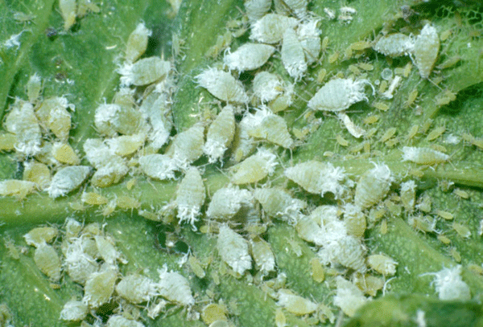
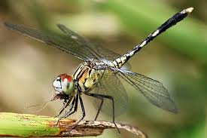
Biological controls of pest and disease.
Biocontrol is the controlling plant disease and pest using biological method.
Example:
The Ladybird are useful to control aphids and Dragonflies for mosquitoes.

Slide 18
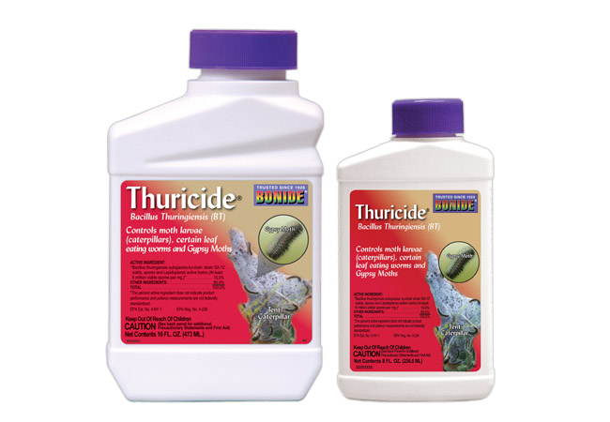
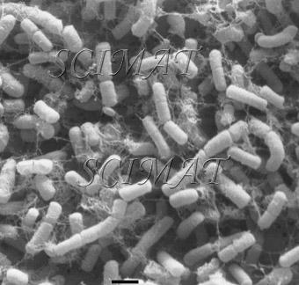
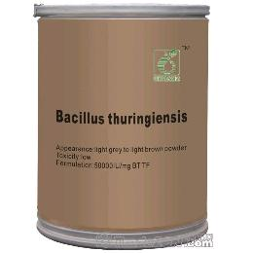
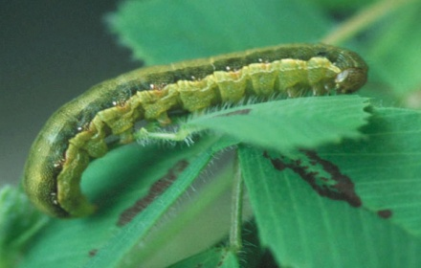
Microbes in Biocontrol:
Bacillus thuringiensis (Bt) used to control caterpillars. Dried spores are mixed with water and sprayed on plants. These are eaten by the insect larvae. In the gut of the larvae, the toxin released kills the larvae.

Slide 19
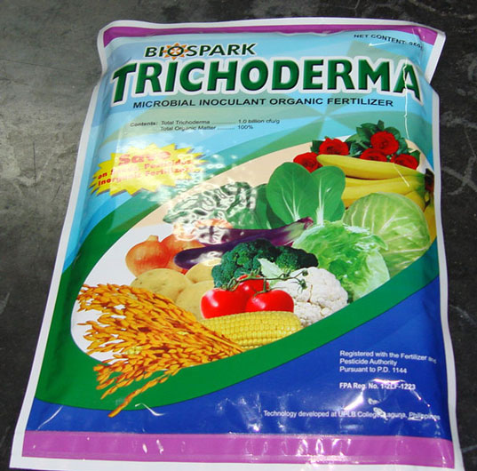
2. Trichoderma a free living fungus used to control several plant pathogens.
Baculoviruses are pathogen that attack insects and other arthropods.
The majority of Baculoviruses belongs to the genus Nucleopolyhedrovirus.
These viruses are species-specific, narrow spectrum insecticidal application. They have no negative impacts on plants, mammals, birds, fish, etc. This is very use full in integrated pest management programme (IPM).

Slide 20
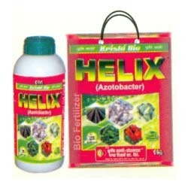
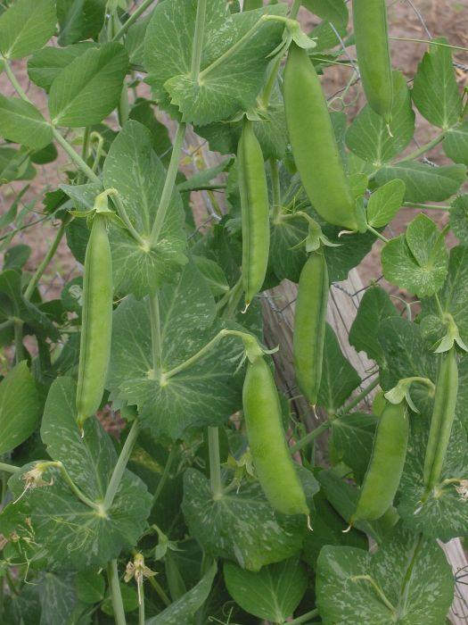
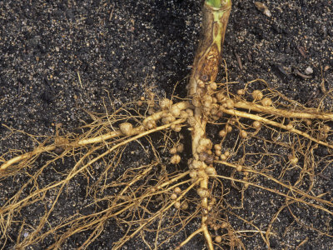
Microbes helps in enriching soil nutrients:
Microbes helps in enriching soil nutrients are called bio fertilizers.
Rhizobium bacteria found in the root nodules of leguminous plants fix free atmospheric nitrogen into nitrate. It is used by the plant as nutrient.
Azospirilium and Azotobacter bacteria fix atmospheric nitrogen and increasing nitrogen content of the soil.

Slide 21
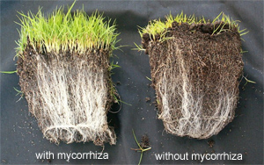
Mycorrhiza fungi symbiotically associated with root of many plants. It provides phosphorus to the plants from the soil.
It Make the plant resistant to root-borne pathogen and increase tolerance to salinity and drought.

Slide 22
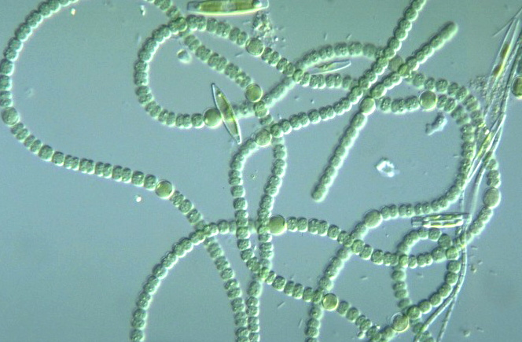
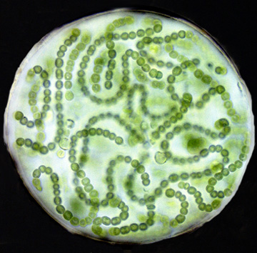
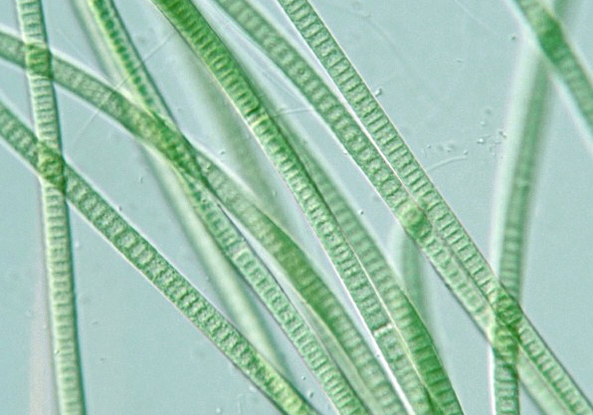
Cyanobacteria are autotrophic microbes widely distributed in aquatic and terrestrial habitats. Many of which fix atmospheric nitrogen and increase soil fertility.
Ex. Anabaena, Nostoc, and Oscillatoria etc.

